Slide 1
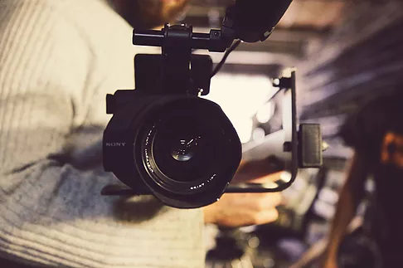
CuriousCam
Çankaya University
16.01.2018

Slide 2
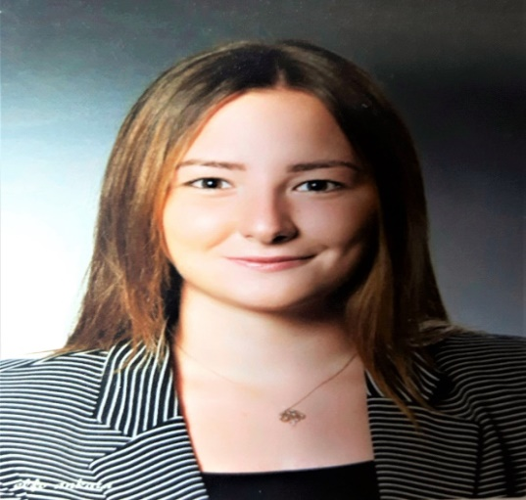
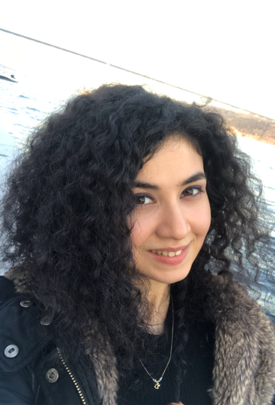
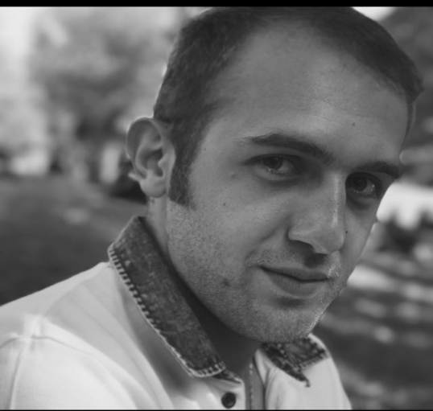
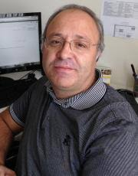
About Us
Bahar Şengez
201511407
Elif Nur Altuntaş
201311003
Alihan Doğuş Yalçın
201611411
Abdül Kadir Görür

Slide 3
CuriousCam
Curious Cam for Video Lecture Recording Environment

Slide 4
CuriousCam is
An autonomous video conference recording system.
Notes:
Birden fazla slayt gerektirebilir

Slide 5
Project Purpose is
While the instructor is talking, using this camera system designed instead of the cameraman that may be in the environment, it is possible to maximize the focus of the trainer and the students by using it instead.

Slide 6
Targets are :
  Technical Targets
  Timelining Targets
  Cost Targets

Slide 7
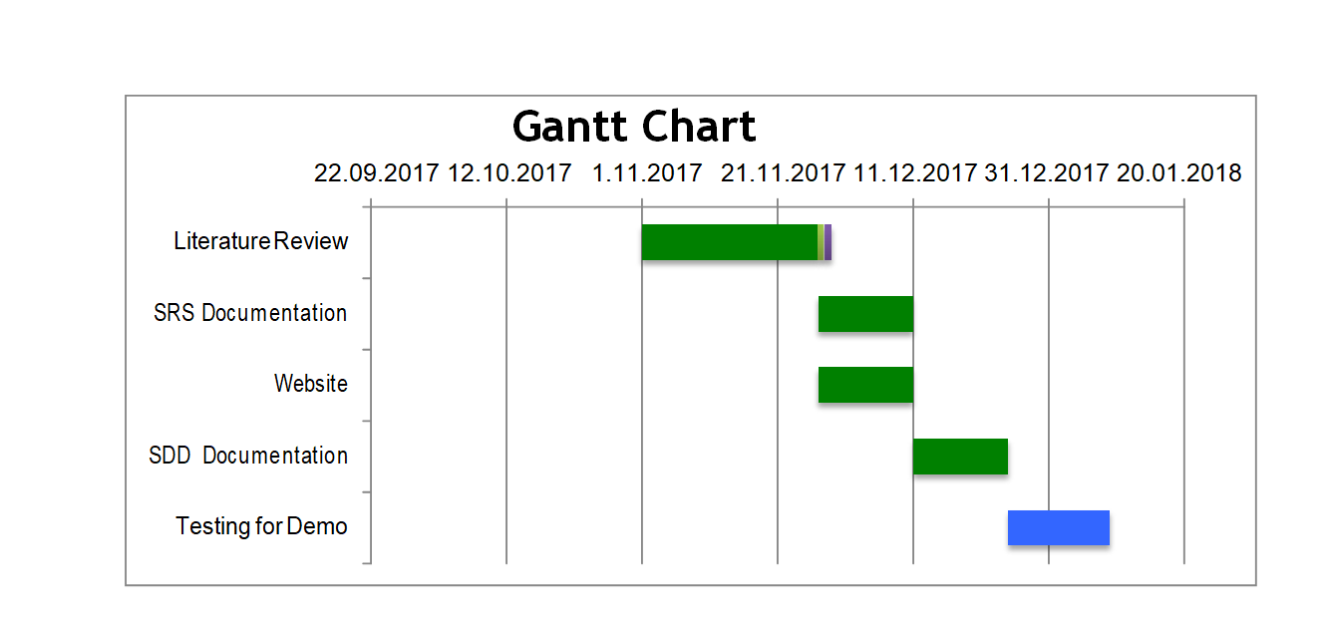
Gannt Chart
Figure : Gantt Chart

Slide 8
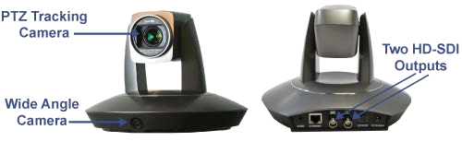
Similar Works
Auto Trackers
Figure : Auto Trackers

Slide 9
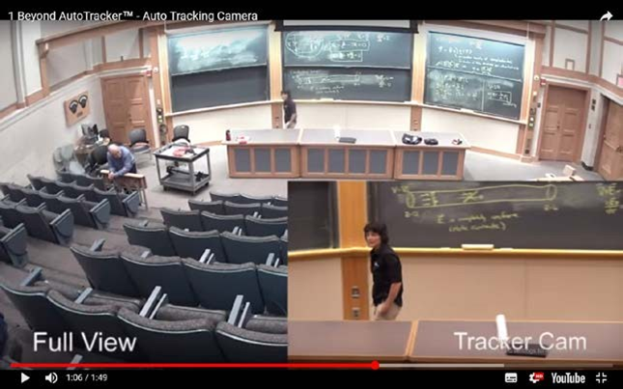
Figure : Auto Tracking Camera

Slide 10
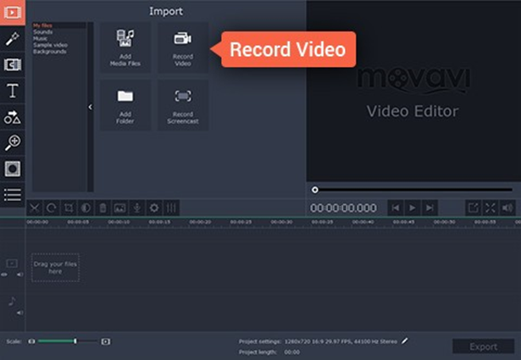
Figure : Movavi
Notes:
Birden fazla slayt gerektirebilir

Slide 11
Solution
System Components

Slide 12
System Components
CuriousCam
Profile Manager
Device Manager
Video Recorder
Video Recording Settings Manager
Camera Orientation Controller
User Tracker
File Manager
Video Player

Slide 13


Profile Manager
  Responsible for managing user personal information: name, surname, instutition, photo, etc.
Device Manager
  Enables the user to determine the basic settings of devices plugged to computer.
  The user can select and test any camera or microphone installed on the system.

Slide 14


Video Recorder
  Responsible of capturing and recording video.
  The user can start, pause, continue and stop video recording.
Video Recording Settings Manager
  Determines the basic properties of the video to be recorded.
  Selects video file save location.
  Sets video and audio quality.
  Customizes video output, putting text or photo on video frame.

Slide 15
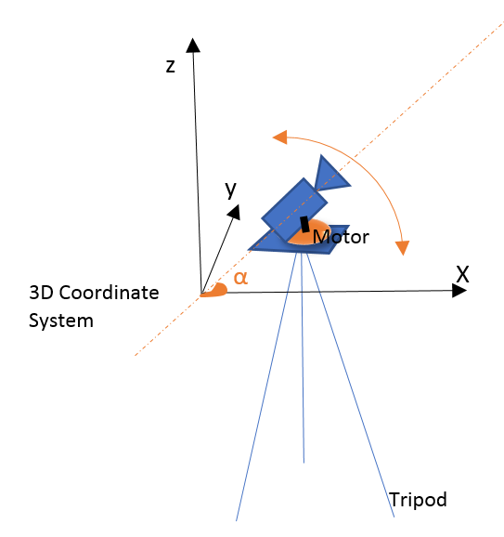
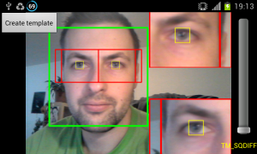
Camera Orientation Controller
  Responsible of based on Raspberry Pi.
  The user can manually change the camera orientation or reset it.
  The mouse buttons are to be used to turn camera right and left.
User Tracker
  Responsible of tracking user in space.
  Provide camera controller with information.
  Uses proper image processing methods such as face detection.

Slide 16

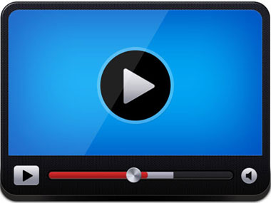
File Manager
  Responsible of managing video files generated by the system.
  It has operations of listing and removing video files existing in the “Save” directory.
  The user can also see or change the basic information of a video file, including, owner, director, producer, etc.
Video Player
  It is the component to display recorded videos.
  It encompasses the basic video playing operations, including start, pause, continue, stop, fast forward, back forward.

Slide 17

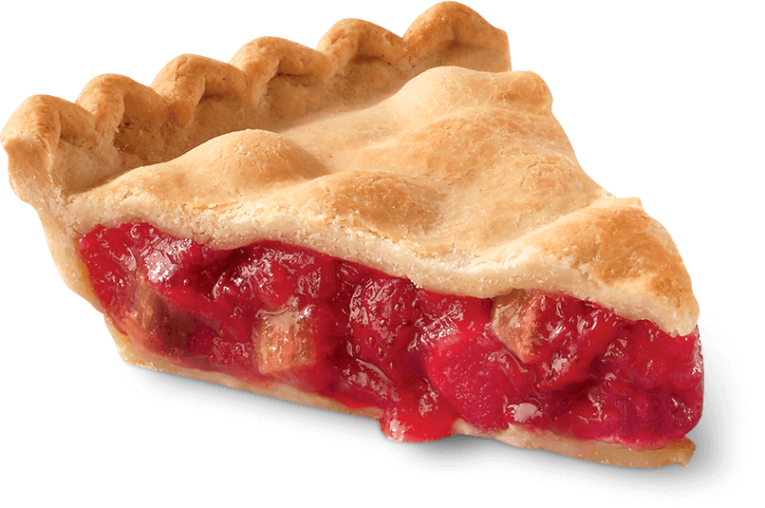
Raspberry Pi 3 [1]
Advantages
Disadvantages
        Accessibility
        Price (~35$)
        CSI Camera Port
        CPU Speed

Slide 18
Alternatives
Asus Tinker Board [2]
Odroid – XU4 [3]
Orange Pi Plus 2 [4]

Slide 19

OpenCV (Open Source Computer Vision) [10]
OpenCV is an open source computer vision and machine learning software library. The library is cross-platform and free for both academic and commercial use under BSD license.

Slide 20
These algorithms can be used to
Detect and recognize faces
Identify objects
Classify human actions in videos
Track camera movements
Track moving objects
Extract 3D models of objects
Produce 3D point clouds from stereo cameras
Stitch images together to produce a high resolution image of an entire scene
Find similar images from an image database
Recognize scenery and establish markers to overlay it with augmented reality, etc.

Slide 21
Alternatives
MATLAB [5]
Halcon [6]
OpenFrameworks [7]
CIMG [8]
Fiji [9]

Slide 22
As a Conclusion ...

Slide 23
REFERENCES
[1] https://www.raspberrypi.org/documentation/
[2] https://www.asus.com/us/Single-Board-Computer/Tinker-Board/
[3] http://www.hardkernel.com/main/products/prdt_info.php
[4] http://www.orangepi.org/orangepiplus2/
[5] https://www.mathworks.com/products/matlab.html
[6] http://www.mvtec.com/products/halcon/
[7] http://openframeworks.cc/
[8] http://cimg.eu/
[9] https://fiji.sc/
[10] https://opencv.org/about.html

Slide 24
Thank You For Listening

Slide 25
Questions ?

